Slide 1
Crediting others References
Fish 290

Slide 2
3. References
Scientific papers use APA (American Psychological Association) format.
In contrast, you may have used MLA (Modern Language Association) format in Humanities courses.
Differences: https://www.scribbr.com/citing-sources/apa-vs-mla/
Note that in-text quotations of other references are common in Humanities, but are not customary in scientific writing.

Slide 3
3. References
In-Text citations:
Cite in-text to:
Give credit to ideas that precede your study
Add credibility (you’re not making things up!)
Allow the reader to learn more
Always include the authors and year:
One author: Moua (2019)
Two authors: Moua and Clawson (2019)
Three or more authors: Moua et al. (2019)
et al. is Latin for “and others”. Notice it is lowercase with period after “al”. This is an abbreviation for “alia” meaning others.

Slide 4
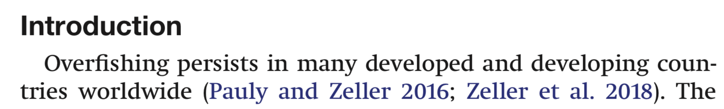
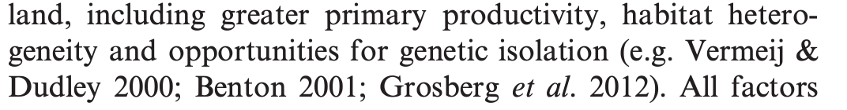
3. References
In-Text citations:
Always include the authors and year:
One author: Moua (2019)
Two authors: Moua and Clawson (2019)
Three or more authors: Moua et al. (2019)
et al. is Latin for “and others”. Notice it is lowercase with period after “al”. This is an abbreviation for “alia” meaning others.
Note that each journal has minor variation on the format:
1:
2:

Slide 5
3. References
The References section:
ALL references that you cited in-text MUST be added here with full-length citation, and NOTHING ELSE
Journals using APA format include the following information in the references, usually in this order:
Jones, R. J. and S. T. Smith. 2005. Mass mortality of long-spine sea urchins: epidemiology and ecological consequences. Marine Biology, 74: 345-356.

Slide 6
3. References
The References section:
ALL references that you cited in-text MUST be added here with full-length citation, and NOTHING ELSE
Journals using APA format include the following information in the references, usually in this order:
Jones, R. J. and S. T. Smith. 2005. Mass mortality of long-spine sea urchins: epidemiology and ecological consequences. Marine Biology, 74: 345-356.
First and middle initials and last names of authors

Slide 7
3. References
The References section:
ALL references that you cited in-text MUST be added here with full-length citation, and NOTHING ELSE
Journals using APA format include the following information in the references, usually in this order:
Jones, R. J. and S. T. Smith. 2005. Mass mortality of long-spine sea urchins: epidemiology and ecological consequences. Marine Biology, 74: 345-356.
Publication year

Slide 8
3. References
The References section:
ALL references that you cited in-text MUST be added here with full-length citation, and NOTHING ELSE
Journals using APA format include the following information in the references, usually in this order:
Jones, R. J. and S. T. Smith. 2005. Mass mortality of long-spine sea urchins: epidemiology and ecological consequences. Marine Biology, 74: 345-356.
Title

Slide 9
3. References
The References section:
ALL references that you cited in-text MUST be added here with full-length citation, and NOTHING ELSE
Journals using APA format include the following information in the references, usually in this order:
Jones, R. J. and S. T. Smith. 2005. Mass mortality of long-spine sea urchins: epidemiology and ecological consequences. Marine Biology, 74: 345-356.
Journal

Slide 10
3. References
The References section:
ALL references that you cited in-text MUST be added here with full-length citation, and NOTHING ELSE
Journals using APA format include the following information in the references, usually in this order:
Jones, R. J. and S. T. Smith. 2005. Mass mortality of long-spine sea urchins: epidemiology and ecological consequences. Marine Biology, 74: 345-356.
Journal volume

Slide 11
3. References
The References section:
ALL references that you cited in-text MUST be added here with full-length citation, and NOTHING ELSE
Journals using APA format include the following information in the references, usually in this order:
Jones, R. J. and S. T. Smith. 2005. Mass mortality of long-spine sea urchins: epidemiology and ecological consequences. Marine Biology, 74: 345-356.
Page range
(sometimes for electronic articles this is an e-number instead)

Slide 12
3. References
How to list references:
Some journals order references in alphabetical order by last name of the first author.
Shark finning is worse now than ever before (Esperanza et al. 2001; Jacoby and Meyers, 2021).
Other journals list by order of appearance in text. Shark finning is worse now than ever before [1,2].

Slide 13
3. References
How to list references:
LOTS of minor variation in format among journals! Always check!
Jones, R. J., and S. T. Smith. 2005.
Jones, R. J., and Smith, S. T. 2005.
Jones, R. J., & Smith, S. T. 2005.
Jones, R J, and Smith, S T. 2005.
Jones R J, Smith ST (2005).
Marine Biology, 74:345–356.
Marine Biology 74:345–356.
Mar. Biol., 74:345–356.*
Mar. Biol., 74: 345–356.*
*Note that every journal has a standard abbreviation that you must look up

Slide 14
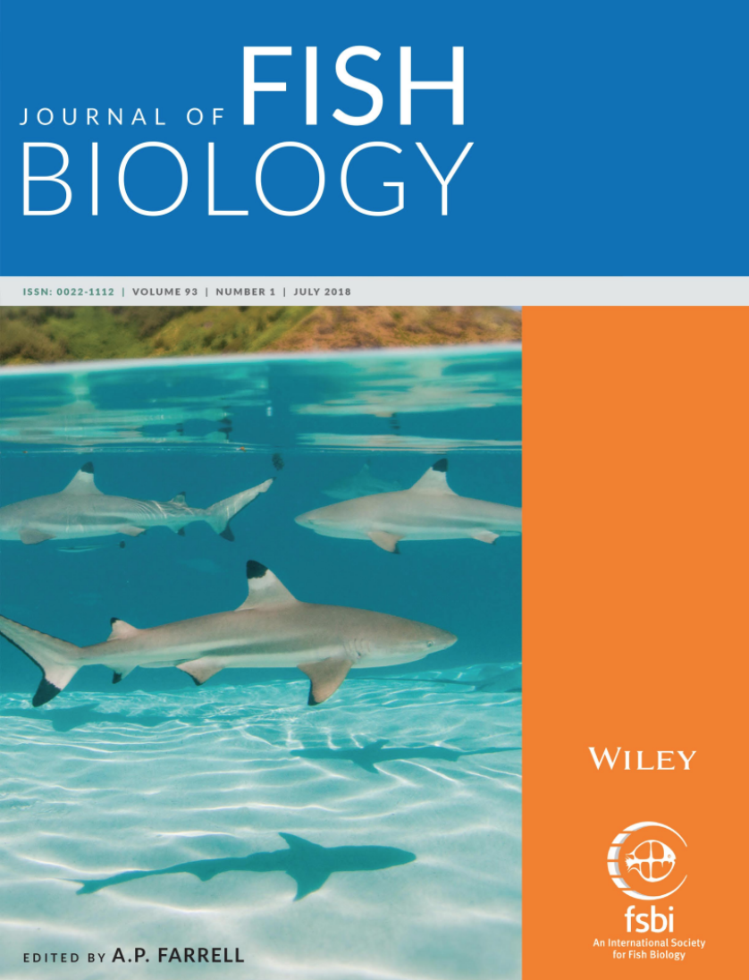
3. References
What do we do in this class?
In this class, you will have in-text citations and a reference list in your research paper.
Let’s use the format from the
Journal of Fish Biology.
See the Author Guidelines or a recent article in this journal: https://onlinelibrary.wiley.com/page/journal/10958649/homepage/forauthors.html

Slide 15
3.1.10 References
All published citations mentioned in the text, tables or figures must be listed in the reference list, which includes all key elements of each reference, including the names of journals in full (not abbreviated). Authors are responsible for checking the accuracy of their references. Manuscript submissions are not required to use JFB reference formatting until the article is provisionally accepted. Corrections may be made during the publication process. A manuscript title must appear exactly as in the original publication. JFB uses APA style referencing with some minor style changes. Examples of JFB reference content requirements are shown below.
Journal Article:
Flowers, K. I., Henderson, A. C., Lupton, J. L., & Chapman, D. D. (2017). Site affinity of whitespotted eagle rays Aetobatus narinari assessed using photographic identification. Journal of Fish Biology, 91, 1337– 1349 Gill, A. B. ( 2003).
Gill, A. B. ( 2003). The dynamics of prey choice in fish: The importance for prey size and satiation. Journal of Fish Biology, 63, 105– 116
Online Article Not Yet Published in an Issue:
Mussen, T. D., & Cech Jr, J. J. (2018). Assessing the use of vibrations and strobe lights at fish screens as enhanced deterrents for two estuarine fishes. Advance online publication. https://doi.org/10.1111/jfb.13776
An online article is cited by its Digital Object Identifier (DOI), which remains valid and allows article tracking even after its allocation to an issue. It has no volume, issue or page numbers.
Book:
Halver, J. E., & Hardy, R. W. ( 2002). Fish nutrition. San Diego, CA: Academic Press
Chapter in a Book:
Mench, J. A., & Mason, G. J. ( 1997). Behaviour. In M. C. Appleby & B. O. Hughes (Eds.), Animal Welfare (pp. 127– 142). New York, NY: CAB International
Docotral Thesis: These must have a permanent record of where they are held (e.g., thesis has been lodged at the individual’s University or Institution Library as a permanent addition to the collection there), e.g., Al‐Badran, A. A. ( 1987). Factors influencing river bank stability in the Tigris and Shatt Al‐ Arab water ways, Iraq (Doctoral thesis, University of Dundee, UK). Retrieved from https://ethos.bl.uk/Home.do;jsessionid=DA702A005B56B131D4E776CD6A605544
Master's Thesis: These must be readily available electronically and the URL provided, e.g., Cox, G. K. (2010). Anoxic survival and cardiovascular responses of the Pacific hagfish, Eptatretus stoutii (Masters thesis). Available from UBC Library https://open.library.ubc.ca/ .
Electronic References: These include references not subject to peer review and formal publication and can be set out as shown given below. ICES (2016). Report of the Baltic salmon and trout assessment working group (WGBAST). ICES CM 2016/ACOM:09. Available at: http://ices.dk/sites/pub/Publication%20Reports/Expert%20Group%20Report/acom/2016/WGBAST/wgbast_2016.pdf
Marshall, A., Bennett, M. B., Kodja, G., Hinojosa-Alvarez, S., Galvan-Magana, F., Harding, M., Stevens, G. & Kashiwagi, T. (2011). Manta birostris. In IUCN Red List of Threatened Species Version 2013.2. Available at http://www.iucnredlist.org/details/198921/0 (last accessed 9 December 2013).

Slide 16
Assignments for today and for home
In class:
Continue to download data for your research project and write your Introduction.
Everyone should aim to have an data file (FORMAT?? PROGRAM??) to analyze on MONDAY.
At home:
Submit by Friday 12 pm: What you have so far of your Introduction. Peer reviews will be assigned Saturday and due Wednesday!
Any writing should be in Word so I can use Track Changes. Name the file “yourname_introduction_thedate.doc”

